Slide 1
TrajMesa: A Distributed NoSQL Storage Engine for Big Trajectory Data
JD Intelligent Cities Research

Slide 2
Outline
Framework of TrajMesa
Introduction to GeoMesa
Storage Schema of TrajMesa
Supported Trajectory Queries
Experiments
Conclusion

Slide 3
Framework of TrajMesa

Slide 4
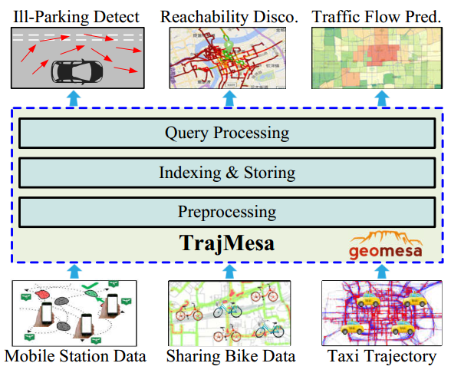
Framework of TrajMesa
Background
  Massive trajectories are generated
  Trajectories are useful by various types of queries
  Desirable for a scalable unified trajectory storage
TrajMesa
  Based on GeoMesa and NoSQL data stores
  Key advantages
    Scalability
      Big Trajectories
    Efficiency
      100~1000 times faster than the-state-of-the-art
    Plenty of queries support
      ID temporal query
      spatial (temporal) range query
      similarity (temporal) query (Frechet, Hausdorff)
      K-NN (temporal) query (Frechet, Hausdorff, Point)
http://trajmesa.urban-computing.com

Slide 5
Introduction to GeoMesa

Slide 6
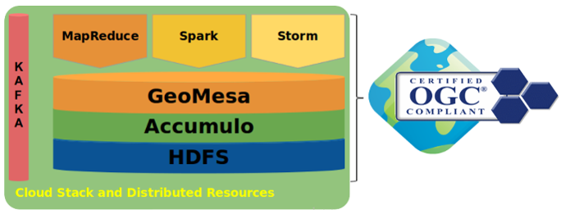

Overview of GeoMesa
An open-source tool for large-scale geospatial querying and analytics
Provide spatio-temporal indexing on top of NoSQL data stores
  HBase, Accumulo, Google Bigtable, Cassandra…
  Based on the Space Filling Curve: Z-order curve
Support Apache Spark for custom distributed geospatial analytics
Follow the standard of OGC (Open Geospatial Consortium)
https://www.geomesa.org/

Slide 7
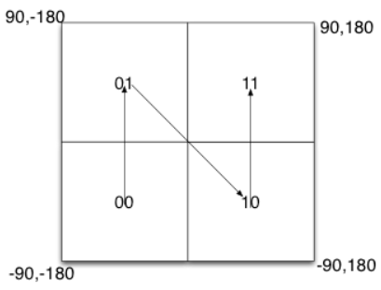
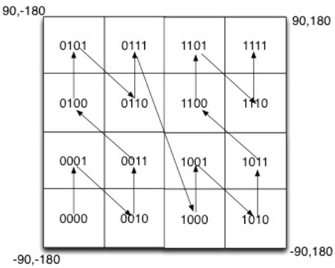
Z-order Curve
Convert multi-dimensional information into one-dimensional key
  Level 1: Split the whole space into four regions, and number them
  Level 2: Recursively split each region further
  Until a certain level is reached
Z-order Curve in Geographic Space (GeoHash)
  Encode latitude and longitude in a way like binary search
  Merge the codes of latitude and longitude in cross way
Level 1
Level 2
Close in Distance (two dimension) ~ Similar Code in Lexicographical Order (one dimension)

Slide 8
Indexing Strategies in GeoMesa
GeoMesa adopts Z-order curve in the underlying indexing strategies
Support 6 types of Indexing Strategies Inherently
  ID Indexing Strategy
  Z2 Indexing Strategy
  Z3 Indexing Strategy
  XZ2 Indexing Strategy
  XZ3 Indexing Strategy
  Attribute Indexing Strategy
All strategies follow a common key combination
Different strategies correspond to different key-value tables, with different keys, but the same values.
Shard (1 byte) + Feature (Optional) + Id
Random number, avoid “Single Point” issue.
Extracted from a data item, not the same in different indexing strategies.
Identifier of a data item, assigned by users or generated randomly.

Slide 9
ID Indexing Strategy
Key combination:
Suitable for the scenes:
  ID query: query a data item with a given id
Shard (1 byte) + Feature (Empty) + Id
Shard (1 byte) + Id

Slide 10
Z2 Indexing Strategy
Key combination:
Suitable for the scenes: point-based spatial range query
Calculation of Z2(lng, lat):
Shard (1 byte) + Z2(lng, lat) (8 bytes) + Id
POINT (116.31412 39.89454)
Max-Min normalize, by a given bit length of 31
normalize()
1767582576
1549702225
1101001010110110010101101110000
1011100010111101001010001010001
Z2SFC.split()
X:0001010001000001000100010100010100000100010001010001010100000000
Y:0001000101010000000100010101010001000001000100000001000100000001
X | Y << 1
0011011011100001001100111110110110000110011001010011100000000010
writeLong
00110110,11100001,00110011,11101101,10000110,01100101,00111000,00000010
toBytes
(54,-31,51,-19,-122,101,55,2)

Slide 11
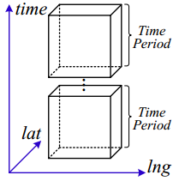
Z3 Indexing Strategy
Key combination:
Suitable for the scenes: point-based spatio-temporal range query
Calculation of Z3(lng, lat, t)
Shard (1 byte) + binNum (2 bytes) + Z3(lng, lat, t) (8 bytes) + Id
POINT (116.31412 39.89454)
2008-02-02 13:30:49
normalize()
normalize()
Max-Min normalize, by a given bit length of 21
1726154
1513381
767877
110100101011011001010
101110001011110100101
10111011011110000101
Z3SFC.split()
X:0001001000001000000001000001000001001000001001000000001000001000
Y:0001000001001001000000000001000001001001001000001000000001000001
T:0000001000001001001000001001000001001001001000000000000001000001
X | Y << 1 | T << 2
0011101010111110100001100111000111111110111001010000001100001110
writeLong
0011101,01011111,01000011,001110001,11111110,11100101,00000011,00001110
toBytes
(58,-66,-122,113,-2,-27,3,-114)

Slide 12
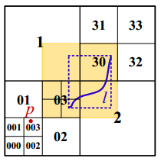
XZ2 Indexing Strategy
Key combination
Suitable for the scenes
  non-point-based spatial range query
Calculation of XZ2(lng, lat)
  Step1: Get the MBR mbr of the non-point data
  Step2: Recursively find the location of the left bottom corner of mbr
  Step3: Repeat Step2 until the XElement of a region just cover the data
    E.g., the orange area is the XElement of 03, it just covers the line l
  Step4: the code of the region is the XZ2 value of the data
    E.g., 03
Shard (1 byte) + XZ2(lng, lat) (8 bytes) + Id
BÖxhm C, Klump G, Kriegel H P. Xz-ordering: A space-filling curve for objects with spatial extension[C]//International Symposium on Spatial Databases. Springer, Berlin, Heidelberg, 1999: 75-90.

Slide 13
XZ3 Indexing Strategy
Key combination
Suitable for the scenes
  non-point-based spatio-temporal range query
Calculation of XZ3(lng, lat, t)
  Similar to the XZ2, but regard the time as a third dimension.
Shard (1 byte) + binNum (2 bytes) + XZ3(lng, lat, t) (8 bytes) + Id

Slide 14
Attribute Indexing Strategy
Key combination
secondTier can be Z2, Z3, XZ2, or XZ3
Suitable for the scenes
  Queries by a given attribute value
Shard (1 byte) + attrValue + 0 (1 byte) + secondTier + Id

Slide 15
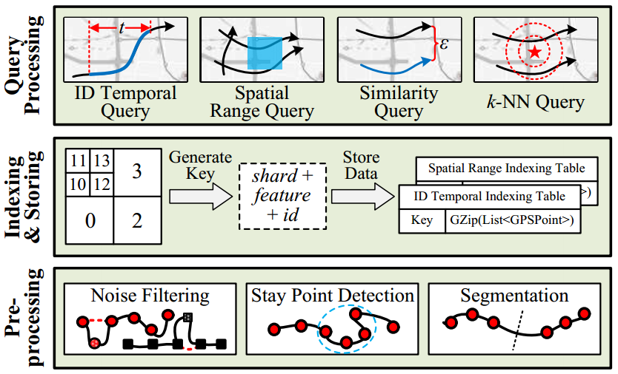
Limitation of GeoMesa for Trajectories
Do not natively support trajectory management
Do not natively support trajectory queries
TrajMesa

Slide 16
Storage Schema of TrajMesa

Slide 17
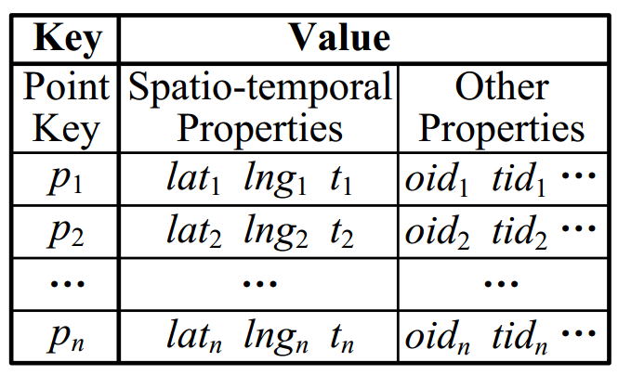
Vertical Storage Schema (V-Store)
Each GPS point in a trajectory is stored as one row
Limitations of V-Store
  Need retrieve all GPS points, group them by tid, sort each group by t
  Not suitable for trajectories, especially for similarity query and k-NN query
  Number of data rows is equal to the number of GPS points
Bigger Storage Space, Slower Query Efficiency

Slide 18
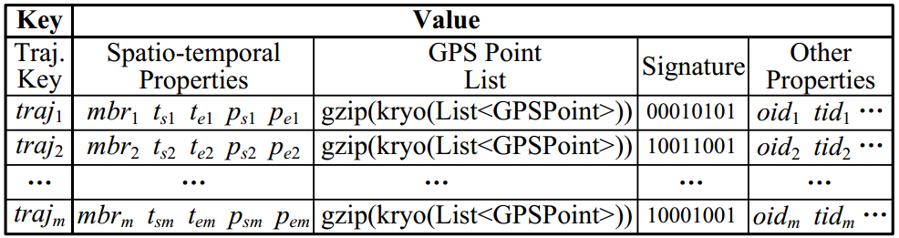
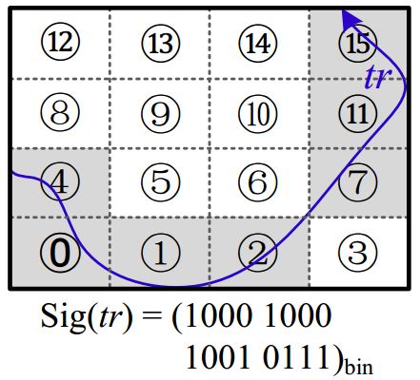
Horizontal Storage Schema (H-Store)
Each trajectory is stored in a single row
GPS points are serialized using Kryo, and then compressed with GZip
Trajectory signature is to provide the fine-grained information of trajectory locations
H-Store
Trajectory Signature
Smaller Storage Space, Faster Query Efficiency

Slide 19
Selection of Serializer and Compressor in H-Store
Gzip(Kryo(List<GPSPoint>)) is relatively faster with a bigger compress ratio.

Slide 20
Supported Trajectory Queries

Slide 21
Summary of Supported Trajectory Queries
ID Temporal Query
Spatial Range Query
Similarity Query (for both Fréchet distance and Hausdorff distance)
K-NN Query (K-NN point query and K-NN trajectory query)
Spatial Temporal Range Query
Similarity Temporal Query
K-NN Temporal Query
…
ID Temporal Indexing Table
Spatial Range Indexing Table
Spatio-Temporal Range Indexing Table
(In paper, we do not include these queries, for the limitation of pages)

Slide 22


ID Temporal Query - Overview
Retrieve the trajectories of a given moving object within a specified time range
Store a copy of trajectories with the keys designed as XZT
  ID Temporal Indexing Table
Key composition of ID Temporal Indexing Table (based on the Attribute Indexing Strategy of GeoMesa)

Slide 23
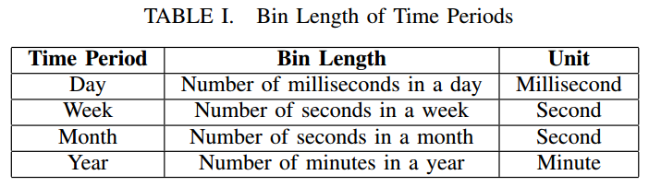
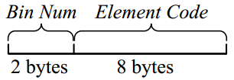
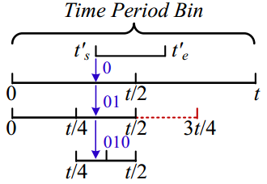

ID Temporal Query - XZT
Key Composition of XZT
BinNum:
Element Code
Usually be 1970-01-01T00:00:00Z
g is the max length of sequence
Step 1. Time Range Transformation
Step 2. Sequence Calculation
Step 3. Code Generation

Slide 24
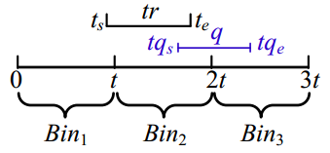
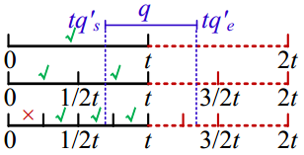
ID Temporal Query - Query Processing
Step 1. Query Window Generation
  shard generation
  oid generation
  BinNum generation
  Offset key range generation in each bin
    XElement of a time range is contained in q?
      Generate an exact key code
    Xelement of a time range is overlapped with q?
      Generate a key code range
  Query window combination
Step 2. Query Execution
Step3. Result Refinement
Key Combination of ID Temporal Indexing Table
Bin₁, Bin₂, and Bin₃ are all satisfied.
An Example of BinNum Generation
An Example of offset key range Generation

Slide 25


Spatial Range Query - Overview
Find the trajectories travelling through a given spatial range
Store a copy of trajectories with the keys designed as XZ2+
  Spatial Range Indexing Table
Key composition of Spatial Range Indexing Table (based on the XZ2 Indexing Strategy of GeoMesa)

Slide 26
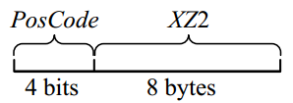
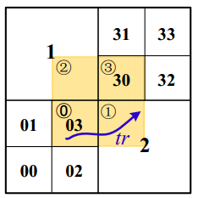

Spatial Range Query - XZ2+
Key Composition of XZ2+
Motivation of Position Code
  XZ2 cannot represent the location of trajectory accurately
Position Code
  Split the XElement into β × β equal-sized regions
  Use β × β bits to represent the trajectory location

Slide 27
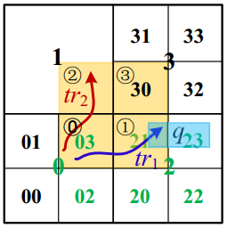
Spatial Range Query - Query Processing
Step 1. Query Window Generation
  shard generation
  Spatial key range generation
    XElement of a region is contained in q?
      Generate an exact key code
    Xelement of a region is overlapped with q?
      Generate a key code range
  PosCode Generation
    E.g., the PosCodes of 03 are: xx1x, i.e., 0010, 0011, 0110, 0111, 1010, 1011, 1110, 1111
Step 2. Query Execution
Step 3. Result Refinement
Key Combination of Spatial Range Indexing Table
Example of Spatial Range Query

Slide 28
Similarity Query - Overview
Return the trajectories similar to a given trajectory. Here, f can be frechet distance f_{F} and Hausdorff distance f_{H}
Use the Spatial Range Indexing Table
Take Spatial Range Query as a Block Function

Slide 29
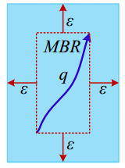
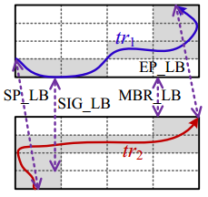

Similarity Query - Query Processing
Given a query trajectory q with a distance threshold ε, q.mbr = {lat_{min}, lng_{min}, lat_{max}, lng_{max}}. All GPS points of a trajectory similar to q should locate in S = {lat_{min}- ε, lng_{min}- ε, lat_{max}+ ε, lng_{max}+ ε}
Multiple lower bounds for pruning
  MBR_LB:
  SEP_LB:
  SIG_LB:
If one of above lower bounds is greater than ε, we can safely stop the calculation of trajectory distance
Lower Bounds

Slide 30


K-NN Query - Overview
Find k trajectories that are most similar to a given trajectory/point q
K-NN point query
  q is a point
  f is f_{P}
K-NN trajectory query
  q is a trajectory
  f can be f_{F} or f_{H}
Use the Spatial Range Indexing Table
Take Spatial Range Query as a Block Function

Slide 31
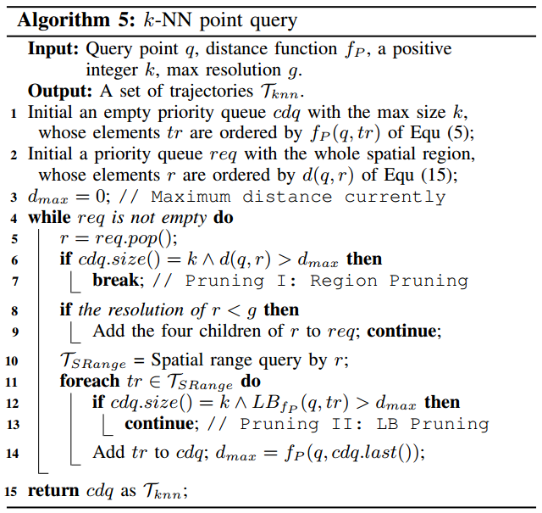
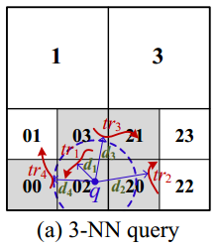
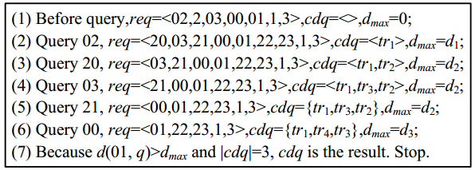
K-NN Point Query – Query Processing
An Example of 3-NN Point Query

Slide 32

K-NN Point Query – Query Processing
Similar to point query, with four differences
  cdq is ordered by f_{F}(q, tr) or f_{H}(q, tr)
  req is ordered by Region_LB
  Use Region_LB to perform Region Pruning
  Use lower bounds proposed in spatial range query to perform LB Pruning

Slide 33
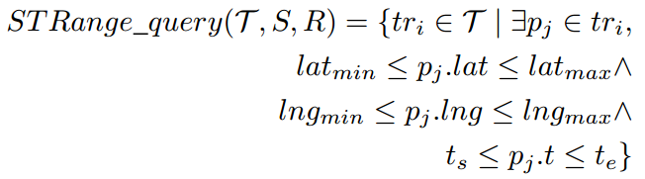
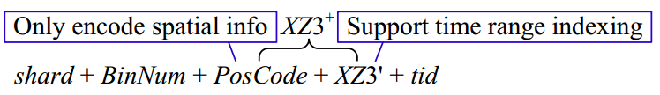
Spatio-Temporal Range Query - Overview
Find the trajectories travelling through a given spatial range and in a given temporal range
Store a copy of trajectories with the keys designed as XZ3+
  Spatial Temporal Range Indexing Table
Key composition of Spatial Range Indexing Table (based on the XZ3 Indexing Strategy of GeoMesa)

Slide 34
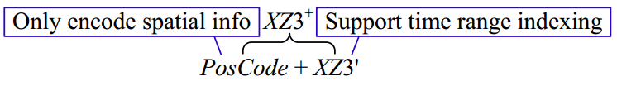
Spatio-Temporal Range Query - XZ3+
Key Composition of XZ3+
In PosCode, we only encode spatial information, as 1) to limit the number of query windows when query processing. (i.e., identical to XZ2+); 2) we have already encoded temporal information in BinNum
XZ3’: XZ3 provided by GeoMesa does not support time range indexing. We implement time range indexing technique (XZT) in XZ3, called XZ3’

Slide 35
Spatio-Temporal Range Query - Query Processing
Step 1. Query Window Generation
  shard generation
  BinNum generation
  Spatial key range generation
    XElement of a region is contained in q?
      Generate an exact key code
    Xelement of a region is overlapped with q?
      Generate a key code range
  PosCode Generation
    E.g., the PosCodes of 03 are: xx1x, i.e., 0010, 0011, 0110, 0111, 1010, 1011, 1110, 1111
Step 2. Query Execution
Step 3. Result Refinement
Key Combination of Spatio-Temporal Range Indexing Table
Example of Spatio-Temporal Range Query

Slide 36

Similarity Temporal Query - Overview
Return the trajectories similar to a given trajectory, and travelling in a given temporal range. Here, f can be frechet distance f_{F} and Hausdorff distance f_{H}
Use the Spatio-Temporal Range Indexing Table
Take Spatio-Temporal Range Query as a Block Function
  Similar to the way that similarity query uses spatial range query

Slide 37
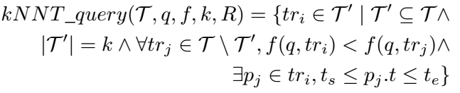
K-NN Temporal Query - Overview
Find k trajectories that are most similar to a given trajectory/point q, and travelling in a given temporal range.
Use the Spatio-Temporal Range Indexing Table
Take Spatio-Temporal Range Query as a Block Function
  Similar to the way that k-NN query uses spatial range query

Slide 38
Experiments

Slide 39
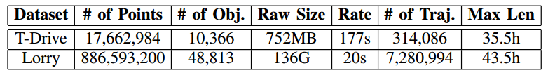
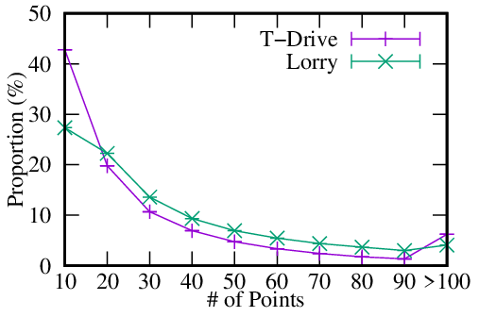
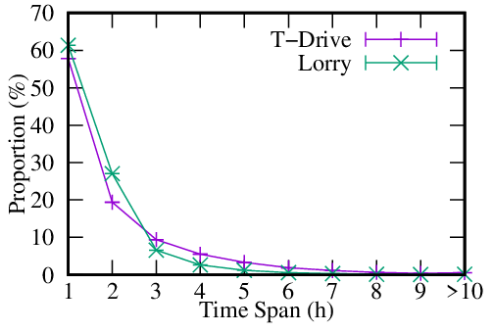
Datasets
One week
One Month
Follow a long tail distribution.

Slide 40
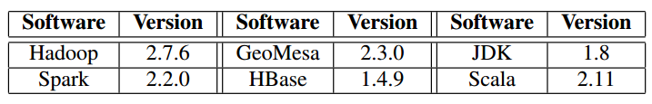
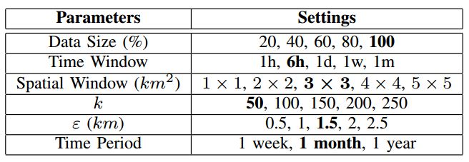
Experimental Settings
15 nodes, Centos 7.4, 8-core CPU, 32GB RAM, 1T disk
Perform 100 queries, and select the mean values as the final results

Slide 41
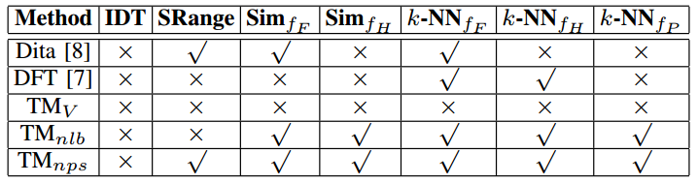
Baselines
Dita: Z. Shang, G. Li, and Z. Bao, “Dita: Distributed in-memory trajectory analytics,” in SIGMOD. ACM, 2018, pp. 725–740.
DFT: D. Xie, F. Li, and J. M. Phillips, “Distributed trajectory similarity search,” VLDB, vol. 10, no. 11, pp. 1478–1489, 2017.
TM_{V}: V-Store of TrajMesa
TM_{nlb}: no lower bounds of TrajMesa
TM_{nps}: no position code of TrajMesa

Slide 42
Performance of Storage - Storage Size
The size Includes 3 Indexing Tables: ID Temporal Indexing Table, Spatial Range Indexing Table, and Spatio-Temporal Indexing Table
V-Store takes more than 5 times of storage space than H-Store
H-Store takes much less storage than the raw data size (Compressed)

Slide 43
Performance of Storage - Storage Time
More data needs more storing time
H-Store takes much less than V-Store

Slide 44
Performance of ID Temporal Query
Querying time is not affected by the trajectory data size (scalability)
Querying time of Lorry is a little more than that T-Drive (sample rate)
Querying time has nothing to do with time period
Larger temporal window causes more querying time

Slide 45
Performance of Spatial Range Query (1)
More data requires more time
TM is faster than TM_nps and Dita
Dita cannot handle big data

Slide 46
Performance of Spatial Range Query (2)
Bigger spatial window needs more time
TM is faster than TM_nps
TM is 40 times faster than Dita in Lorry data
Note we use 60% of Lorry data, as Dita cannot handle more data

Slide 47
Performance of Similarity Query – f_{F}

Slide 48
Performance of Similarity Query – f_{H}

Slide 49
Performance of K-NN Query - f_{F}

Slide 50
Performance of K-NN Query - f_{H}

Slide 51
Performance of K-NN Query - f_{P}

Slide 52
Performance of Spatio-Temporal Query (1)

Slide 53
Performance of Spatio-Temporal Query (2)

Slide 54
Conclusion

Slide 55
Contributions of TrajMesa
Take the first attempt to build a holistic distributed NoSQL trajectory storage engine based on GeoMesa
Proposed a novel trajectory storage schema, i.e., H-Store
Devised a novel indexing key schema, i.e., XZT, for time ranges, which can support ID temporal query efficiently
Proposed a position code to indicate the spatial location of trajectories accurately, which accelerates spatial (temporal) range query
Proposed a bunch of pruning strategies for similarity (temporal) query and K-NN (temporal) query
Extensive experiments are conducted using two trajectory datasets

